Slide 1
Chapter 4
Lexical and Syntax Analysis

Slide 2
Chapter 4 Topics
Introduction
Lexical Analysis
The Parsing Problem
Recursive-Descent Parsing
Bottom-Up Parsing

Slide 3
Introduction
Language implementation systems must analyze source code, regardless of the specific implementation approach
Nearly all syntax analysis is based on a formal description of the syntax of the source language (BNF)

Slide 4
Syntax Analysis *
The syntax analysis portion of a language processor nearly always consists of two parts:
  A low-level part called a lexical analyzer (mathematically, a finite automaton based on a regular grammar)
  A high-level part called a syntax analyzer, or parser (mathematically, a push-down automaton based on a context-free grammar, or BNF)
Notes:
Lexical – homework

Slide 5
Advantages of Using BNF to Describe Syntax
Provides a clear and concise syntax description
The parser can be based directly on the BNF
Parsers based on BNF are easy to maintain

Slide 6
Reasons to Separate Lexical and Syntax Analysis
Simplicity - less complex approaches can be used for lexical analysis; separating them simplifies the parser
Efficiency - separation allows optimization of the lexical analyzer
Portability - parts of the lexical analyzer may not be portable, but the parser always is portable

Slide 7
Lexical Analysis *
A lexical analyzer is a pattern matcher for character strings
A lexical analyzer is a “front-end” for the parser
Identifies substrings of the source program that belong together - lexemes
  Lexemes match a character pattern, which is associated with a lexical category called a token
  sum is a lexeme; its token may be IDENT

Slide 8
Lexical Analysis (continued)
The lexical analyzer is usually a function that is called by the parser when it needs the next token
Three approaches to building a lexical analyzer:
  Write a formal description of the tokens and use a software tool that constructs a table-driven lexical analyzer from such a description
  Design a state diagram that describes the tokens and write a program that implements the state diagram
  Design a state diagram that describes the tokens and hand-construct a table-driven implementation of the state diagram

Slide 9
State Diagram Design
  A naïve state diagram would have a transition from every state on every character in the source language - such a diagram would be very large!
  <id> -> <letter>+
  <letter> -> a | b | c | d
b
Repeat for a, c, and d…
s2
b
s0
c
s3
d
a
s4
s1

Slide 10
Lexical Analysis (continued)
In many cases, transitions can be combined to simplify the state diagram
  When recognizing an identifier, all uppercase and lowercase letters are equivalent
    Use a character class that includes all letters
  When recognizing an integer literal, all digits are equivalent - use a digit class

Slide 11
Lexical Analysis (continued)
Reserved words and identifiers can be recognized together (rather than having a part of the diagram for each reserved word)
  Use a table lookup to determine whether a possible identifier is in fact a reserved word
    Match word, search table for reserved word first
    Treated as exceptions of names tokens (subset of all name tokens)

Slide 12
Lexical Analysis (continued)
Convenient utility subprograms (function):
  getChar - gets the next character of input, puts it in nextChar, determines its class and puts the class in charClass
  addChar - puts the character from nextChar into the place the lexeme is being accumulated, lexeme
  lookup - determines whether the string in lexeme is a reserved word (returns a code)

Slide 13
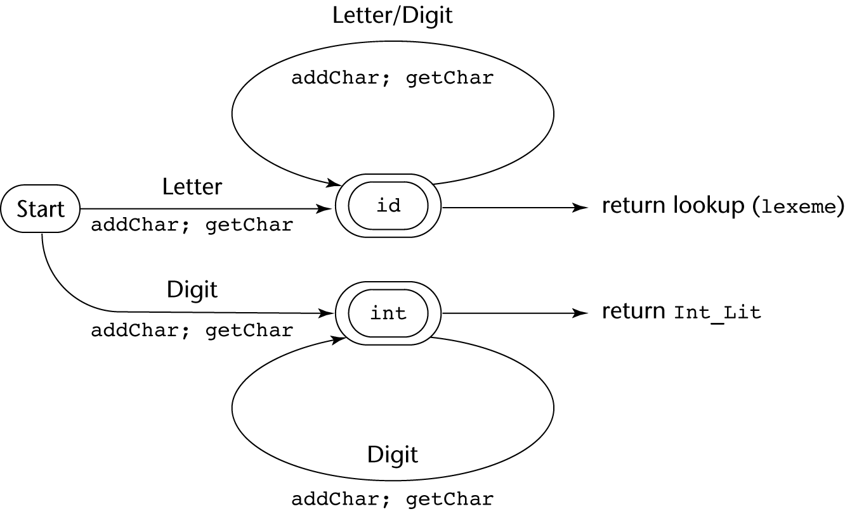
State Diagram

Slide 14
Lexical Analyzer
Implementation:
→ See Book front.c (pp. 166-177)
- Following is the output of the lexical analyzer of
front.c when used on (sum + 47) / total
Next token is: 25 Next lexeme is (
Next token is: 11 Next lexeme is sum
Next token is: 21 Next lexeme is +
Next token is: 10 Next lexeme is 47
Next token is: 26 Next lexeme is )
Next token is: 24 Next lexeme is /
Next token is: 11 Next lexeme is total
Next token is: -1 Next lexeme is EOF

Slide 15
The Parsing Problem *
Goals of the parser, given an input program:
  Find all syntax errors; for each, produce an appropriate diagnostic message and recover quickly
  Produce the parse tree, or at least a trace of the parse tree, for the program

Slide 16
The Parsing Problem (continued) *
Two categories of parsers
  Top down - produce the parse tree, beginning at the root
    Order is that of a leftmost derivation
    Traces or builds the parse tree in preorder
  Bottom up - produce the parse tree, beginning at the leaves
    Order is that of the reverse of a rightmost derivation
Useful parsers look only one token ahead in the input

Slide 17
The Parsing Problem (continued) *
Top-down Parsers
  Given a sentential form, xAα , the parser must choose the correct A-rule to get the next sentential form in the leftmost derivation, using only the first token produced by A
The most common top-down parsing algorithms:
  Recursive descent - a coded implementation
  LL(k) parsers - table driven implementation

Slide 18
The Parsing Problem (continued) *
Bottom-up parsers
  Given a right sentential form, α, determine what substring of α is the right-hand side of the rule in the grammar that must be reduced to produce the previous sentential form in the right derivation
  The most common bottom-up parsing algorithms are in the LR family

Slide 19
The Parsing Problem (continued)
The Complexity of Parsing
  Parsers that work for any unambiguous grammar are complex and inefficient ( O(n³), where n is the length of the input )
  Compilers use parsers that only work for a subset of all unambiguous grammars, but do it in linear time ( O(n), where n is the length of the input )

Slide 20
Recursive-Descent Parsing *
There is a subprogram for each nonterminal in the grammar, which can parse sentences that can be generated by that nonterminal
EBNF is ideally suited for being the basis for a recursive-descent parser, because EBNF minimizes the number of nonterminals

Slide 21
Example Grammar 1
BNF
<assgn> -> <var> = <expr>
<expr> -> <var> + <var>
<var> -> a | b | c
Derivation
<assgn> => <var> = <expr>
a = <expr> => a = <var> + <var>
a = b + <var> => a = b + c

Slide 22
Example Grammar 1 Parse Tree
<assgn>
<var> = <expr>
a <var> + <var>
b c

Slide 23
Example Grammar 1 Parse Trace
Enter <assgn>
Enter <var>
Token: a
Token: =
Enter <expr>
Enter <var>
Token: b
Token: +
Enter <var>
Token: c

Slide 24
Recursive-Descent Parsing (continued)
A grammar for simple expressions:
<expr> → <term> {(+ | -) <term>}
<term> → <factor> {(* | /) <factor>}
<factor> → id | int_constant | ( <expr> )

Slide 25
Recursive-Descent Parsing (continued)
Assume we have a lexical analyzer named lex, which puts the next token code in nextToken
The coding process when there is only one RHS:
  For each terminal symbol in the RHS, compare it with the next input token; if they match, continue, else there is an error
  For each nonterminal symbol in the RHS, call its associated parsing subprogram

Slide 26
Recursive-Descent Parsing (continued)
/* Function expr
Parses strings in the language
generated by the rule:
<expr> → <term> {(+ | -) <term>}
*/
void expr() {
/* Parse the first term */
term();
/* As long as the next token is + or -, call
lex to get the next token and parse the
next term */
while (nextToken == ADD_OP ||
nextToken == SUB_OP){
lex();
term();
}
}

Slide 27
Recursive-Descent Parsing (continued)
This particular routine does not detect errors
Convention: Every parsing routine leaves the next token in nextToken

Slide 28
Recursive-Descent Parsing (continued)
A nonterminal that has more than one RHS requires an initial process to determine which RHS it is to parse
  The correct RHS is chosen on the basis of the next token of input (the lookahead)
  The next token is compared with the first token that can be generated by each RHS until a match is found
  If no match is found, it is a syntax error

Slide 29
Recursive-Descent Parsing (continued)
/* term
Parses strings in the language generated by the rule:
<term> -> <factor> {(* | /) <factor>)
*/
void term() {
/* Parse the first factor */
factor();
/* As long as the next token is * or /,
next token and parse the next factor */
while (nextToken == MULT_OP || nextToken == DIV_OP) {
lex();
factor();
}
} /* End of function term */

Slide 30
Recursive-Descent Parsing (continued)
/* Function factor
Parses strings in the language
generated by the rule:
<factor> -> id | int_constant | (<expr>) */
void factor() {
/* Determine which RHS */
if (nextToken) == ID_CODE || nextToken == INT_CODE)
/* For the RHS id, just call lex */
lex();
/* If the RHS is (<expr>) – call lex to pass over the left parenthesis,
call expr, and check for the right parenthesis */
else if (nextToken == LP_CODE) {
lex();
expr();
if (nextToken == RP_CODE)
lex();
else
error();
} /* End of else if (nextToken == ... */
else error(); /* Neither RHS matches */
}

Slide 31
Recursive-Descent Parsing (continued)
- Trace of the lexical and syntax analyzers on (sum + 47) / total
Next token is: 25 Next lexeme is ( Next token is: 11 Next lexeme is total
Enter <expr> Enter <factor>
Enter <term> Next token is: -1 Next lexeme is EOF
Enter <factor> Exit <factor>
Next token is: 11 Next lexeme is sum Exit <term>
Enter <expr> Exit <expr>
Enter <term>
Enter <factor>
Next token is: 21 Next lexeme is +
Exit <factor>
Exit <term>
Next token is: 10 Next lexeme is 47
Enter <term>
Enter <factor>
Next token is: 26 Next lexeme is )
Exit <factor>
Exit <term>
Exit <expr>
Next token is: 24 Next lexeme is /
Exit <factor>

Slide 32
Problems for Recursive-Descent Parsing (LL)*
Direct Recursion
A -> A + B | some_terminal
Indirect recursión
A -> B a A
B -> A b

Slide 33
Recursive-Descent Parsing (continued) *
Removing DIRECT Left Recursion
The LL Grammar Class
  The Left Recursion Problem
    If a grammar has left recursion, either direct or indirect, it cannot be the basis for a top-down parser
      A grammar can be modified to remove direct left recursion as follows:
      For each nonterminal, A,
      Group the A-rules as A → Aα₁ | … | Aα_{m} | β₁ | β₂ | … | β_{n}
      where none of the β‘s begins with A
      2. Replace the original A-rules with
      A → β₁A’ | β₂A’ | … | β_{n}A’
      A’ → α₁A’ | α₂A’ | … | α_{m}A’ | ε
Notes:
Direct Recursion
A -> A + B | some_terminal
Indirect recursión
A -> B a A
B -> A b

Slide 34
Example (DIRECT Left Recursion)
E -> E + T | T
T -> T * F | F
F -> (E) | id
For the E-rules, we have α1 = + T and β = T, so we replace the E-rules with
E -> TE’
E’ -> + TE’ | ε
Can we remove left-recursion from the other rule?
T → FT‘
T' → * FT' | ε
F → (E) | id

Slide 35
DIRECT Left Recursion Recap
Create a new rule
For every definition in rule A that does NOT start with a recursive call to A, leave it as a definition of A and add a call to the new rule
For every definition in rule A that DOES START with a recursive call to A
  Remove the recursive call to A (only that)
  Put the rest of it in the new rule as another definition and add a recursive call to the new rule after
Add epsilon to new rule

Slide 36
Example (DIRECT Left Recursion) – Numbers from previous slide
E -> E + T | T
T -> T * F | F
F -> (E) | id
E -> TE’
E’ -> + TE’ | ε
T → FT‘
T' → * FT' | ε
F → (E) | id
2
3
1
4
2
3
1
4

Slide 37
Recursive-Descent Parsing (continued) *
Removing INDIRECT Left Recursion
The LL Grammar Class
  The INDIRECT Left Recursion Problem
  Rewrite the rule with the indirect left recursion such that it’s definitions INCLUDE the definitions of the Rule that it is indirectly calling recursively
  THEN, simply remove direct recursion using the technique of the previous slides
Notes:
Direct Recursion
A -> A + B | some_terminal
Indirect recursión
A -> B a A
B -> A b

Slide 38
Example (INDIRECT Left Recursion)
E -> E + T | T
T -> T * F | F
F -> E | id
Here one definition for E calls rule F and one definition for rule F indirectly calls rule E again
We FIRST need to remove the direct recursion in E (This will be a problem for the next step if we don’t).
THEN, rewrite F to include definitions in E (so that we now JUST have direct recursion in F.
THEN, simply remove the direct recursion from F.

Slide 39
Example (INDIRECT Left Recursion)
E -> E + T | T E -> TE’
T -> T * F | F E’-> + TE’ | ε
F -> E | id T -> T * F | F
F -> E | id
We FIRST need to remove the direct recursion in E (This will be a problem for the next step if we don’t).

Slide 40
Example (INDIRECT Left Recursion)
E -> TE’ | FE’ E -> TE’
E’-> + TE’ | ε E’-> + TE’ | ε
T -> T * F | F T -> FT’
F -> E | id T’-> * FT’ | ε
F -> E | id
Since E could be T and T could be F and F could be E, we also need to remove the direct recursion in T.

Slide 41
Think about it like math equalities
E -> TE’
E’-> + TE’ | ε
T -> FT’
T’-> * FT’ | ε
F -> E | id
Equalities:
E = TE’
E’ = + TE’
E’ = ε
T = FT’
T’ = * FT’
T’ = ε
F = E
F = id

Slide 42
Another way to think about it
(math equalities)
E -> TE’
E’-> + TE’ | ε
T -> FT’
T’-> * FT’ | ε
F -> E | id
F -> TE’ | id
Equalities:
E = TE’
E’ = + TE’
E’ = ε
T = FT’
T’ = * FT’
T’ = ε
F = E
F = id

Slide 43
Another way to think about it
(math equalities)
E -> TE’
E’-> + TE’ | ε
T -> FT’
T’-> * FT’ | ε
F -> E | id
F -> TE’ | id
F -> FT’E’ | id
Equalities:
E = TE’
E’ = + TE’
E’ = ε
T = FT’
T’ = * FT’
T’ = ε
F = E
F = id

Slide 44
Example (INDIRECT Left Recursion)
E -> TE’ E -> TE’
E’-> + TE’ | ε E’-> + TE’ | ε
T -> FT’ T -> FT’
T’-> * FT’ | ε T’-> * FT’ | ε
F -> FT’E’ | id F -> idF’
F’-> T’E’F’| ε
Now, we can simply remove the direct recursion in F.

Slide 45
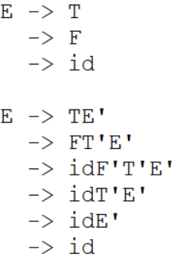
Example (INDIRECT Left Recursion)
E -> E + T | T E -> TE’
T -> T * F | F E’-> + TE’ | ε
F -> E | id T -> FT’
T’-> * FT’ | ε
F -> idF’
F’-> T’E’F’ | ε
Are they semantically equivalent?

Slide 46
Exercise (INDIRECT Left Recursion)
E -> E + T | T E -> TE’
T -> T * F | F E’-> + TE’ | ε
F -> E | id T -> FT’
T’-> * FT’ | ε
F -> idF’
F’-> T’E’F’ | ε
Derive “id * id” using both the left and the right versions of this grammar.

Slide 47
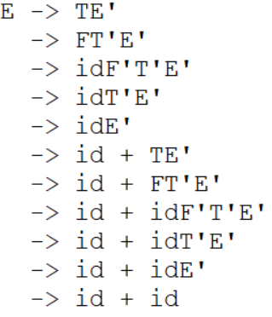
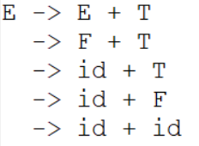
Example (INDIRECT Left Recursion)
E -> E + T | T E -> TE’
T -> T * F | F E’-> + TE’ | ε
F -> E | id T -> FT’
T’-> * FT’ | ε
F -> idF’
F’-> T’E’F’ | ε
Are they semantically equivalent?

Slide 48
Recursive-Descent Parsing (continued) *
The other characteristic of grammars that disallows top-down parsing is the lack of pairwise disjointness
  The inability to determine the correct RHS on the basis of one token of lookahead
  Def: FIRST(α) = {a | α =>* aβ }
(If α =>* ε, ε is in FIRST(α))
- In English: For any rule with multiple
definitions, the FIRST set is the first terminal
symbol that appears in each definition.
=>* means 0 or more derivation steps
Notes:
=>* means 0 or more derivation steps

Slide 49
In-Class Exercise FIRST set *
What is the FIRST set for the A rule in the grammar below?
A -> aB | bAb | Bb
B -> cB | d
a, b, c, d

Slide 50
Recursive-Descent Parsing (continued) *
Pairwise Disjointness Test:
  For each nonterminal, A, in the grammar that has more than one RHS, for each pair of rules, A → α_{i} and A → α_{j}, it must be true that
FIRST(α_{i}) ⋂ FIRST(α_{j}) = φ
Example:
A → a | bB | cAb
A → a | aB

Slide 51
Recursive-Descent Parsing (continued) *
Left factoring can resolve the problem
Replace
<variable> → identifier | identifier [<expression>]
with
<variable> → identifier <new>
<new> → ε | [<expression>]
or
<variable> → identifier [[<expression>]]
(the outer brackets are metasymbols of EBNF)

Slide 52
In-Class Exercise
Can you resolve the pairwise disjointness of the following rule? Do so by creating a new rule (not by using EBNF notation).
A → a | aB
A → aA’
A’ → ε | B

Slide 53
Bottom-up Parsing
The parsing problem is finding the correct RHS in a right-sentential form to reduce to get the previous right-sentential form in the derivation

Slide 54
Bottom-up Parsing (continued) *
Intuition about handles (continued):
  The handle of a right sentential form is its leftmost simple phrase
  Given a parse tree, it is now easy to find the handle
  Parsing can be thought of as handle pruning

Slide 55
Sample Derivation Showing Handles
Grammar
E -> E + T | T
T -> T * F | F
F -> (E) | id
Rightmost Derivation
E => E + T
=> E + T * F
=> E + T * id
=> E + F * id
=> E + id * id
=> T + id * id
=> F + id * id (“prune” id)
=> id + id * id (handle is id)
The underlined pieces are what is getting “pruned” from the tree. Think about pruning as removing some set of symbols from a derivation and replacing them with some other set of symbols.

Slide 56
Bottom-up Parsing (handles & phrases)
Intuition about handles:
  Def: β is the handle of the right sentential form
γ = αβw if and only if S =>*_{rm} αAw =>_{rm} αβw
  Def: β is a phrase of the right sentential form
γ if and only if S =>* γ = α₁Aα₂ =>+ α₁βα₂
S =>* γ = E + T * F => E + T * id (id is
a phrase & a simple phrase & a handle)
S =>* γ = E + T * F => E + T * id (T * id is a phrase only,
there are others)
* A Phrase can also be a simple phrase and a Handle
* The current Handle will ALWAYS be a simple phrase
* A simple phrase is not necessarily a Handle (only the left-most will be the current handle if there are more than one simple phrases present)
Notes:
=>* 0 or more derivation steps
Exactly 1 derivation step
+ 1 or more derivation step

Slide 57
Bottom-up Parsing (Sentential Ex)
The parsing problem is finding the correct RHS in a right-sentential form to reduce to get the previous right-sentential form in the derivation
Sentential Form Example:
Grammar αAw: A = F
E -> E + T | T RHS1 = F + id * id
T -> T * F | F RHS2 = id + id * id
F -> (E) | id αβw: β = id
β is the handle

Slide 58
Bottom-up Parsing (Partial Tree Ex)
The parsing problem is finding the correct RHS in a right-sentential form to reduce to get the previous right-sentential form in the derivation
Partial Tree Example:
E -> E + T | T
T -> T * F | F
F -> (E) | id
Sentencial Form:
E + T * id
E
T
F
E
+
T
*
id

Slide 59
Bottom-up Parsing (Handle Pruning)
Once you find a handle, “prune” it from the tree and look for the next handle.
Pruning is simply replacing a handle with the rule it was derived from. The result should be the previous sentential form in a right-most derivation
Partial Tree Example:
E -> E + T | T
T -> T * F | F
F -> (E) | id
Current Sentencial Form:
E + T * id
Previous Sentential Form: E + T * F
Handle: id
E
T
F
E
+
T
*
id

Slide 60
Phrases & Simple Phrases
E
T
F
E + T * id
Phrases Simple Phrases
E + T * id id
T * id Handle
id id

Slide 61
In Class Exercise *
After Removing the handle of the tree from the previous slide:
  What are the phrases now?
  What are the simple phrases now?
  What is the handle that you “prune”?
  Draw the new tree (after “pruning” it)

Slide 62
Bottom-up Parsing (continued) *
Shift-Reduce Algorithms
  Reduce is the action of replacing the handle on the top of the parse stack with its corresponding LHS
  Shift is the action of moving the next token to the top of the parse stack
Other useful Examples:
  Good and bad parse using shift-reduce
  Shift-reduce example using table
  Another Shift-reduce example
  DFA’s

Slide 63
Bottom-up Parsing (continued) *
Advantages of LR parsers:
  They will work for nearly all grammars that describe programming languages.
  They work on a larger class of grammars than other bottom-up algorithms, but are as efficient as any other bottom-up parser.
  They can detect syntax errors as soon as it is possible.
  The LR class of grammars is a superset of the class parsable by LL parsers.

Slide 64
Bottom-up Parsing (continued)
LR parsers must be constructed with a tool
Knuth’s insight: A bottom-up parser could use the entire history of the parse, up to the current point, to make parsing decisions
  There are only a finite and relatively small number of different parse situations that could have occurred, so the history could be stored in a parser state, on the parse stack

Slide 65
Bottom-up Parsing (continued) *
LR parsers are table driven, where the table has two components, an ACTION table and a GOTO table
  The ACTION table specifies the action of the parser, given the parser state and the next token
    Rows are state names; columns are terminals
  The GOTO table specifies which state to put on top of the parse stack after a reduction action is done
    Rows are state names; columns are nonterminals

Slide 66
LR Parser
An LR configuration stores the state of an LR parser
stack input
(S₀X₁S₁X₂S₂…X_{m}S_{m},| a_{i}a_{i+1}…a_{n}$)
input string: E . + T

Slide 67
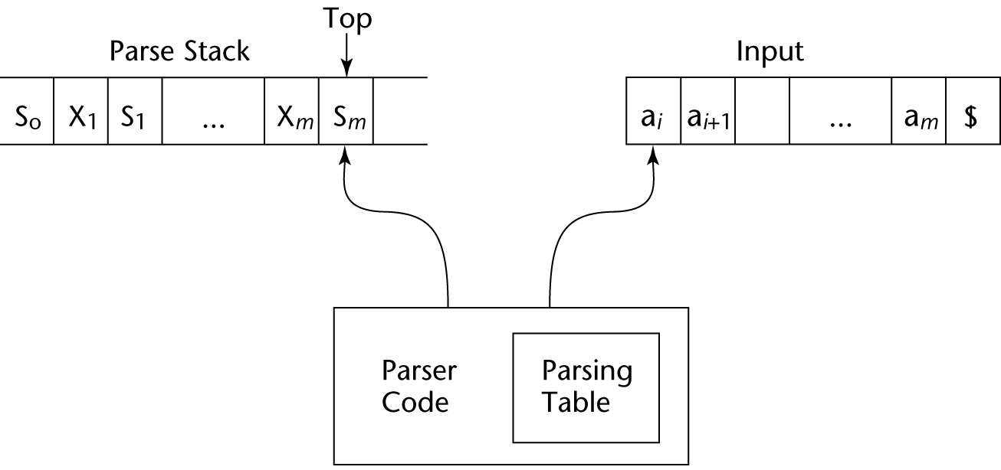
Structure of An LR Parser

Slide 68
Bottom-up Parsing (continued) *
Initial configuration: (S₀, a₁…a_{n}$)
Parser actions:
  For a Shift, the next symbol of input is pushed onto the stack, along with the state symbol that is part of the Shift specification in the Action table
  For a Reduce, remove the handle from the stack, along with its state symbols. Push the LHS of the rule. Push the state symbol from the GOTO table, using the state symbol just below the new LHS in the stack and the LHS of the new rule as the row and column into the GOTO table

Slide 69
Bottom-up Parsing (continued)
Parser actions (continued):
  For an Accept, the parse is complete and no errors were found.
  For an Error, the parser calls an error-handling routine.

Slide 70
Bottom-up Parse Example *
(this slide to the end) *
Rewrite our rules (no |’s)
E -> E+T | T E -> E + T
T -> id E -> T
T -> id

Slide 71
Bottom-up Parse Example
Rewrite our rules (no |’s)
Add a starting rule
S’ ->E$
E -> E+T | T E -> E + T
T -> id E -> T
T -> id

Slide 72
Bottom-up Parse Example
Rewrite our rules (no |’s)
Add a starting rule
Number the rules
r0: S’ ->E$
E -> E+T | T r1: E -> E + T
T -> id r2: E -> T
r3: T -> id

Slide 73
Bottom-up Parse Example
Rewrite our rules (no |’s)
Add a starting rule
Number the rules
Create closures for all the rules (DFA)
Number the closures
r0: S’ ->E$
E -> E+T | T r1: E -> E + T
T -> id r2: E -> T
r3: T -> id

Slide 74
Closures
An LR configuration stores the state of an LR parser
stack input
(S₀X₁S₁X₂S₂…X_{m}S_{m},| a_{i}a_{i+1}…a_{n}$)
input string: E . + T

Slide 75
Create closures for rules
A closure represents all possible configurations for a given state
If the next symbol (after the .) is a non-terminal, then all productions of that non-terminal are included
We want to define states for valid sequences of symbols (terminal and non-terminal)
Begin with start production
S’ ->E$
E -> E + T
E -> T
T -> id
S’ -> .E

Slide 76
Create closures for rules
A closure represents all possible configurations for a given state
If the next symbol (after the .) is a non-terminal, then all productions of that non-terminal are included
We want to define states for valid sequences of symbols (terminal and non-terminal)
Begin with start production
S’ ->E$
E -> E + T
E -> T
T -> id
S’ -> .E
E -> .E + T
E -> .T

Slide 77
Create closures for rules
A closure represents all possible configurations for a given state
If the next symbol (after the .) is a non-terminal, then all productions of that non-terminal are included
We want to define states for valid sequences of symbols (terminal and non-terminal)
Begin with start production
S’ ->E$
E -> E + T
E -> T
T -> id
S’ -> .E
E -> .E + T
E -> .T
T -> .id
Notes:
Id in source code file
Remember we’re doing this backwards
Show quick derivation for just id + id
Nonterminals (E, T, etc…) represent some combination of lexemes
The state you’re defining actually represents what’s on the stack

Slide 78
Create closures for rules
S’ ->E$
E -> E + T
E -> T
T -> id
S0
S’ -> .E
E -> .E + T
E -> .T
T -> .id

Slide 79
Define closures for all transitions
S’ ->E$
E -> E + T
E -> T
T -> id
S0
S’ -> .E
E -> .E + T
E -> .T
T -> .id
id
S1
T -> id.
(This will be a reduction state)

Slide 80
Create closures for all transitions
S’ ->E$
E -> E + T
E -> T
T -> id
S2
S0
S’ -> .E
E -> .E + T
E -> .T
T -> .id
E
S’ -> E.$
E -> E. + T
id
S1
T -> id.
(This will be a reduction state)

Slide 81
Create closures for all transitions
S’ ->E$
E -> E + T
E -> T
T -> id
(These will be a reduction state)
S3
E -> T.
T
S2
S0
S’ -> .E
E -> .E + T
E -> .T
T -> .id
E
S’ -> E.$
E -> E. + T
id
S1
T -> id.
(This will be a reduction state)

Slide 82
Create closures for all transitions
S’ ->E$
E -> E + T
E -> T
T -> id
(These will be a reduction state)
S3
E -> T.
T
S2
S4
S0
S’ -> .E
E -> .E + T
E -> .T
T -> .id
E
S’ -> E.$
E -> E. + T
+
E -> E +. T
T -> .id
id
S1
T -> id.
(This will be a reduction state)

Slide 83
Create closures for all transitions
S’ ->E$
E -> E + T
E -> T
T -> id
(These will be a reduction state)
S3
E -> T.
T
S2
S4
S0
S’ -> .E
E -> .E + T
E -> .T
T -> .id
E
S’ -> E.$
E -> E. + T
+
E -> E +. T
T -> .id
id
T
id
S1
T -> id.
S5
E -> E + T.
(This will be a reduction state)
(This will be a reduction state)

Slide 84
Bottom-up Parse Example
Rewrite our rules (no |’s)
Add a starting rule
Number the rules
Create closures for all the rules (DFA) and number them
Create Transition table from our DFA
r0: S’ ->E$
E -> E+T | T r1: E -> E + T
T -> id r2: E -> T
r3: T -> id

Slide 85
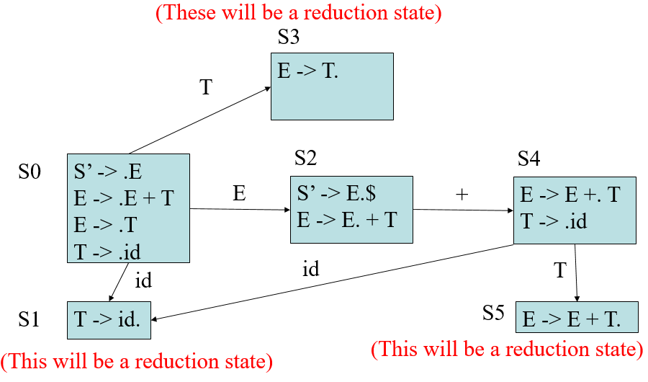
Create Transition Table
r0: S’ ->E$
r1: E -> E + T
r2: E -> T
r3: T -> id
 | + | id | E | T
0 |  | 1 | 2 | 3
1
2
3
4
5

Slide 86
Create Transition Table
r0: S’ ->E$
r1: E -> E + T
r2: E -> T
r3: T -> id
 | + | id | E | T
0 |  | 1 | 2 | 3
1 | Nothing | Yet!
2
3
4
5

Slide 87
Create Transition Table
r0: S’ ->E$
r1: E -> E + T
r2: E -> T
r3: T -> id
 | + | id | E | T
0 |  | 1 | 2 | 3
1
2 | 4
3
4
5

Slide 88
Create Transition Table
r0: S’ ->E$
r1: E -> E + T
r2: E -> T
r3: T -> id
 | + | id | E | T
0 |  | 1 | 2 | 3
1
2 | 4
3 | No | transition
4
5

Slide 89
Create Transition Table
r0: S’ ->E$
r1: E -> E + T
r2: E -> T
r3: T -> id
 | + | id | E | T
0 |  | 1 | 2 | 3
1
2 | 4
3
4 |  | 1 |  | 5
5

Slide 90
Bottom-up Parse Example
Rewrite our rules (no |’s)
Add a starting rule
Number the rules
Create closures for all the rules (DFA) and number them
Create Transition table from DFA
Create Parser Table from Transition table
  Sn -> next state is n
  Rn -> reduce using rule n
  acc -> accept as valid input
  <empty>/error -> invalid input

Slide 91
Create Parser Table
r0: S’ ->E$
r1: E -> E + T
r2: E -> T
r3: T -> id
State | Action |  |  | Goto
 | + | Id | $ | E | T
0
1
2
3
4
5
 | + | id | E | T
S0 |  | 1 | 2 | 3
S1
S2 | 4
S3
S4 |  | 1 |  | 5
S5

Slide 92
Create Parser Table
r0: S’ ->E$
r1: E -> E + T
r2: E -> T
r3: T -> id
State | Action |  |  | Goto
 | + | Id | $ | E | T
0 |  | S1 |  | 2 | 3
1
2
3
4
5
 | + | id | E | T
S0 |  | 1 | 2 | 3
S1
S2 | 4
S3
S4 |  | 1 |  | 5
S5

Slide 93
Create Parser Table
r0: S’ ->E$
r1: E -> E + T
r2: E -> T
r3: T -> id
State | Action |  |  | Goto
 | + | Id | $ | E | T
0 |  | S1 |  | 2 | 3
1 | R3 | R3 | R3
2 | …
3
4
5
 | + | id | E | T
S0 |  | 1 | 2 | 3
S1
S2 | 4
S3
S4 |  | 1 |  | 5
S5

Slide 94
Create Parser Table
r0: S’ ->E$
r1: E -> E + T
r2: E -> T
r3: T -> id
State | Action |  |  | Goto
 | + | Id | $ | E | T
0 |  | S1 |  | 2 | 3
1 | R3 | R3 | R3
2 | S4 |  | acc
3 | R2 | R2 | R2
4 |  | S1 |  |  | 5
5 | R1 | R1 | R1
 | + | id | E | T
S0 |  | 1 | 2 | 3
S1
S2 | 4
S3
S4 |  | 1 |  | 5
S5

Slide 95
Parse Input String using PDA (Push Down Automata)
stack input
(S₀X₁S₁X₂S₂…X_{m}S_{m},| a_{i}a_{i+1}…a_{n}$)
input string: E . + T

Slide 96
Parse Input String using PDA (Push Down Automata)
State | Action |  |  | Goto
 | + | Id | $ | E | T
0 |  | S1 |  | 2 | 3
1 | R3 | R3 | R3
2 | S4 |  | acc
3 | R2 | R2 | R2
4 |  | S1 |  |  | 5
5 | R1 | R1 | R1
r0: S’ ->E$
r1: E -> E + T
r2: E -> T
r3: T -> id
input: .id + id $
stack: 0
Output:

Slide 97
Parse Input String using PDA (Push Down Automata)
State | Action |  |  | Goto
 | + | Id | $ | E | T
0 |  | S1 |  | 2 | 3
1 | R3 | R3 | R3
2 | S4 |  | acc
3 | R2 | R2 | R2
4 |  | S1 |  |  | 5
5 | R1 | R1 | R1
r0: S’ ->E$
r1: E -> E + T
r2: E -> T
r3: T -> id
input: id . + id $
stack: 0 id 1
Output:

Slide 98
Parse Input String using PDA (Push Down Automata)
State | Action |  |  | Goto
 | + | Id | $ | E | T
0 |  | S1 |  | 2 | 3
1 | R3 | R3 | R3
2 | S4 |  | acc
3 | R2 | R2 | R2
4 |  | S1 |  |  | 5
5 | R1 | R1 | R1
r0: S’ ->E$
r1: E -> E + T
r2: E -> T
r3: T -> id
input: id . + id $
stack: 0 T
Output: 3,

Slide 99
Parse Input String using PDA (Push Down Automata)
State | Action |  |  | Goto
 | + | Id | $ | E | T
0 |  | S1 |  | 2 | 3
1 | R3 | R3 | R3
2 | S4 |  | acc
3 | R2 | R2 | R2
4 |  | S1 |  |  | 5
5 | R1 | R1 | R1
r0: S’ ->E$
r1: E -> E + T
r2: E -> T
r3: T -> id
input: id . + id $
stack: 0 T 3
Output: 3,

Slide 100
Parse Input String using PDA (Push Down Automata)
State | Action |  |  | Goto
 | + | Id | $ | E | T
0 |  | S1 |  | 2 | 3
1 | R3 | R3 | R3
2 | S4 |  | acc
3 | R2 | R2 | R2
4 |  | S1 |  |  | 5
5 | R1 | R1 | R1
r0: S’ ->E$
r1: E -> E + T
r2: E -> T
r3: T -> id
input: id . + id $
stack: 0 E
Output: 3, 2,

Slide 101
Parse Input String using PDA (Push Down Automata)
State | Action |  |  | Goto
 | + | Id | $ | E | T
0 |  | S1 |  | 2 | 3
1 | R3 | R3 | R3
2 | S4 |  | acc
3 | R2 | R2 | R2
4 |  | S1 |  |  | 5
5 | R1 | R1 | R1
r0: S’ ->E$
r1: E -> E + T
r2: E -> T
r3: T -> id
input: id . + id $
stack: 0 E 2
Output: 3, 2,

Slide 102
Parse Input String using PDA (Push Down Automata)
State | Action |  |  | Goto
 | + | Id | $ | E | T
0 |  | S1 |  | 2 | 3
1 | R3 | R3 | R3
2 | S4 |  | acc
3 | R2 | R2 | R2
4 |  | S1 |  |  | 5
5 | R1 | R1 | R1
r0: S’ ->E$
r1: E -> E + T
r2: E -> T
r3: T -> id
input: id + . id $
stack: 0 E 2 +
Output: 3, 2,

Slide 103
Parse Input String using PDA (Push Down Automata)
State | Action |  |  | Goto
 | + | Id | $ | E | T
0 |  | S1 |  | 2 | 3
1 | R3 | R3 | R3
2 | S4 |  | acc
3 | R2 | R2 | R2
4 |  | S1 |  |  | 5
5 | R1 | R1 | R1
r0: S’ ->E$
r1: E -> E + T
r2: E -> T
r3: T -> id
input: id + . id $
stack: 0 E 2 + 4
Output: 3, 2,

Slide 104
Parse Input String using PDA (Push Down Automata)
State | Action |  |  | Goto
 | + | Id | $ | E | T
0 |  | S1 |  | 2 | 3
1 | R3 | R3 | R3
2 | S4 |  | acc
3 | R2 | R2 | R2
4 |  | S1 |  |  | 5
5 | R1 | R1 | R1
r0: S’ ->E$
r1: E -> E + T
r2: E -> T
r3: T -> id
input: id + id . $
stack: 0 E 2 + 4 id
Output: 3, 2,

Slide 105
Parse Input String using PDA (Push Down Automata)
State | Action |  |  | Goto
 | + | Id | $ | E | T
0 |  | S1 |  | 2 | 3
1 | R3 | R3 | R3
2 | S4 |  | acc
3 | R2 | R2 | R2
4 |  | S1 |  |  | 5
5 | R1 | R1 | R1
r0: S’ ->E$
r1: E -> E + T
r2: E -> T
r3: T -> id
input: id + id . $
stack: 0 E 2 + 4 id 1
Output: 3, 2,

Slide 106
Parse Input String using PDA (Push Down Automata)
State | Action |  |  | Goto
 | + | Id | $ | E | T
0 |  | S1 |  | 2 | 3
1 | R3 | R3 | R3
2 | S4 |  | acc
3 | R2 | R2 | R2
4 |  | S1 |  |  | 5
5 | R1 | R1 | R1
r0: S’ ->E$
r1: E -> E + T
r2: E -> T
r3: T -> id
input: id + id . $
stack: 0 E 2 + 4 T
Output: 3, 2, 3,

Slide 107
Parse Input String using PDA (Push Down Automata)
State | Action |  |  | Goto
 | + | Id | $ | E | T
0 |  | S1 |  | 2 | 3
1 | R3 | R3 | R3
2 | S4 |  | acc
3 | R2 | R2 | R2
4 |  | S1 |  |  | 5
5 | R1 | R1 | R1
r0: S’ ->E$
r1: E -> E + T
r2: E -> T
r3: T -> id
input: id + id . $
stack: 0 E 2 + 4 T 5
Output: 3, 2, 3,

Slide 108
Parse Input String using PDA (Push Down Automata)
State | Action |  |  | Goto
 | + | Id | $ | E | T
0 |  | S1 |  | 2 | 3
1 | R3 | R3 | R3
2 | S4 |  | acc
3 | R2 | R2 | R2
4 |  | S1 |  |  | 5
5 | R1 | R1 | R1
r0: S’ ->E$
r1: E -> E + T
r2: E -> T
r3: T -> id
input: id + id . $
stack: 0 E
Output: 3, 2, 3, 1

Slide 109
Parse Input String using PDA (Push Down Automata)
State | Action |  |  | Goto
 | + | Id | $ | E | T
0 |  | S1 |  | 2 | 3
1 | R3 | R3 | R3
2 | S4 |  | acc
3 | R2 | R2 | R2
4 |  | S1 |  |  | 5
5 | R1 | R1 | R1
r0: S’ ->E$
r1: E -> E + T
r2: E -> T
r3: T -> id
input: id + id . $
stack: 0 E 2
Output: 3, 2, 3, 1

Slide 110
Parse Input String using PDA (Push Down Automata)
State | Action |  |  | Goto
 | + | Id | $ | E | T
0 |  | S1 |  | 2 | 3
1 | R3 | R3 | R3
2 | S4 |  | acc
3 | R2 | R2 | R2
4 |  | S1 |  |  | 5
5 | R1 | R1 | R1
r0: S’ ->E$
r1: E -> E + T
r2: E -> T
r3: T -> id
input: id + id $ .
stack: 0 E 2 $
Output: 3, 2, 3, 1

Slide 111
Parse Input String using PDA (Push Down Automata)
State | Action |  |  | Goto
 | + | Id | $ | E | T
0 |  | S1 |  | 2 | 3
1 | R3 | R3 | R3
2 | S4 |  | acc
3 | R2 | R2 | R2
4 |  | S1 |  |  | 5
5 | R1 | R1 | R1
r0: S’ ->E$
r1: E -> E + T
r2: E -> T
r3: T -> id
input: id + id $ .
stack: accept!
Output: 3, 2, 3, 1

Slide 112
Parse Input String using PDA (Push Down Automata)
r0: S’ ->E$
r1: E -> E + T
r2: E -> T
r3: T -> id
id + id
Output: 3, 2, 3, 1
Derivation
E => E + T (1)
=> E + id (3)
=> T + id (2)
=> id + id (3)

Slide 113
Handles, Phrases, Simple Phrases Revisited
Grammar
r0: S’ ->E$
r1: E -> E + T
r2: E -> T
r3: T -> id
Derivation
E => E + T (1)
=> E + id (3)
=> T + id (2)
=> id + id (3)
Example on Chalkboard
Parse tree
  Phrases/simple phrases vs Handles
Derivation
  Terminology (RHS, Sentence, etc…)

Slide 114
Bottom-up Parsing (continued)
A parser table can be generated from a given grammar with a tool, e.g., yacc or bison

Slide 115
Summary
Syntax analysis is a common part of language implementation
A lexical analyzer is a pattern matcher that isolates small-scale parts of a program
  Detects syntax errors
  Produces a parse tree
A recursive-descent parser is an LL parser
  EBNF
Parsing problem for bottom-up parsers: find the substring of current sentential form
The LR family of shift-reduce parsers is the most common bottom-up parsing approach

